Slide 1

DEPARTMENT OF COMPUTER ENGINEERING SHAH AND ANCHOR KUTCHHI ENGINEERING COLLEGE CHEMBUR, MUMBAI-400088 2017 - 2018

Slide 2
E-COMMERCE PRODUCT REVIEW MANAGEMENT SYSTEM BASED ON OPINION MINING BY
Name | Class
Sujith Nair | BE-4-38
Apresh Pandit | BE-4-42
Sanal Pillai | BE-4-46
Onkaar Sawant | BE-4-57
Under the guidance of
Prof. Rupali Kale

Slide 3
TABLE of content:
1. Abstract
2. Introduction
3. Proposed System
4. Hardware and Software Requirements.
5. Algorithm
6. Conclusion

Slide 4
Abstract :
The growth of E-commerce has led to the invention of several websites that market and sells products as well as allows users to post reviews.
However, since the product reviews are written by non experts in an unstructured, natural language text, the task of summarizing them is challenging.
It includes various phases like
Preprocessing
Feature extraction and pruning
Feature based opinion summarization
Opinion sentiment classification.

Slide 5
Introduction :
The Internet offers an effective, global platform for E-commerce,
communication, and opinion sharing in natural language.
Mining through these terabytes of user review data is a challenging knowledge engineering task.
Hence, in recent years researchers have proposed approaches for mining user-expressed opinions from several domains and so forth
Our focus in this paper is efficient feature extraction, sentiment polarity classification, and comparative feature summary generation of online product reviews.

Slide 6
Continued..
Most online shopping sites also allow users to post reviews of products purchased. There are also dedicated sites that post product reviews by experts as well as end users.
The main difficulty in analyzing these online users’ reviews is that they are in the form of natural language.

Slide 7
Proposed System :
We generated an opinion review database by crawling some popular websites that categorically post product reviews by actual users. Our product opinion summarizer has three main phases. These phases are
(1) Preprocessing phase,
(2) Feature extraction phase, and
(3) Opinion summarization and classification phase.

Slide 8
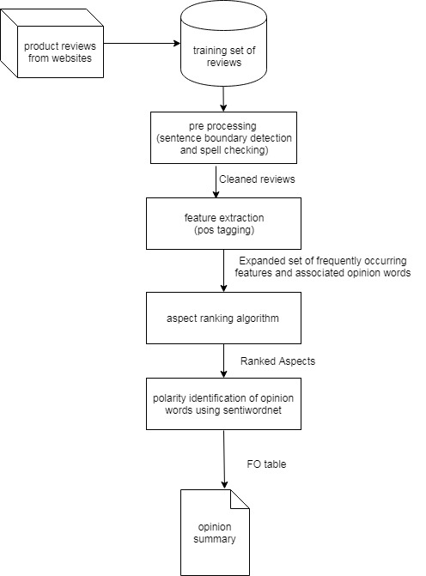
System Architecture Diagram

Slide 9
Hardware Software Requirements :
HARDWARE REQUIREMENTS:
1 GB RAM.
200 GB HDD.
Intel 1.66 GHz Processor Pentium 4
SOFTWARE REQUIREMENTS:
Windows XP, Windows 7,8
Visual Studio 2010
MS SQL Server 2008
Windows Operating System

Slide 10
Algorithm used
Let
D={r1, r2,r3…rn} be the set of reviews.
Ak= {a1, a2, a3,…… an} be the set of aspect
Ca,D is the number of times aspect term a occurs in review dataset D.
|P| is the number of comments in the positively labeled set.
|N| is the number of comments in the negatively labeled set.
Va,D is the feature value for aspect term a in review dataset D.
Let Φ = set of positive words
Let ψ = set of negative words
ω weight of aspect a

Slide 11
Continued...
Steps
Calculate the value of aspect a, given by
Va,D= Ca,D*log2(|P|/Pa)−Ca,D∗log2(|N|/ Na)
= Ca,D*log2((|P|Na /Pa|N|)
= Ca,D*log2(Na/Pa)
Calculate the occurrence probability of each positively opinionated word.
n
α = ∑ P(Φi)∗W(Φi)
i=1
Calculate the occurrence probability of each negatively opinionate word.
n
β = ∑ P(ψi)∗W(ψi)
i=1
Calculate weight,
D
ω = Va,D − ∑(α – β)
i=1

Slide 12
Conclusion :
Classifying and summarizing opinions of bloggers has several interesting and commercially significant applications. However, this task is much more difficult than classifying regular text and requires intensive preprocessing.
The success of the opinion mining task is mainly dependent on the efficiency and sophistication of the preprocessing and feature extraction steps.
This project allows one to gain understanding of the overall sentiment of the user review.

